Slide 1
Development and Evaluation of “World of Balance,” a Multiplayer Online Game for Ecology Education and Research
Ilmi Yoon, Gary Ng, David Hoff and CSc 631/831 students
Computer Science Dept
San Francisco State Univ.

Slide 2
Outline
Related Work
Human Computing, Crowd Computing, Gamification
Science Discovery Game
My Collaborative Research with Computational Ecologists (Biodiversity and Sustainability)
Challenges in Computation Ecology Research
Steps towards Ecology Science Discovery Game
World of Balance (lobby and mini games)
Development
CSc 631/831 students (Multiplayer Online Dev. Course)
Github
Discussion/Next Steps

Slide 3
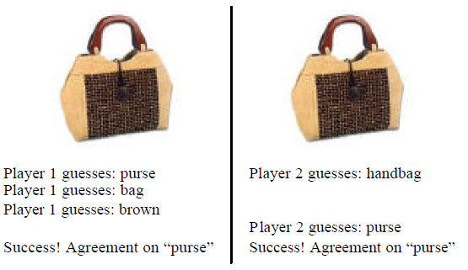
Related Work (Gamification, Crowd Computing)
ESP Game (Image Labeling Game) Luis von Ahn, 2005
Can computer program (AI + Vision) label images as human do?
Can a person make objective label? Maybe yes, but how effectively?
Use human as smart processor while computer does all the rest
Entertain crowd
Acquired by Google

Slide 4
Science Discovery Game --- Foldit, Protein Folding Game
Prove that more complex scientific problems can be solved with human-directed computing.
Protein structure prediction - locating the biologically relevant native conformation of a protein is a formidable computational challenge given the very large size of the search space.
Engages non-scientists in solving hard prediction problems.

Slide 5
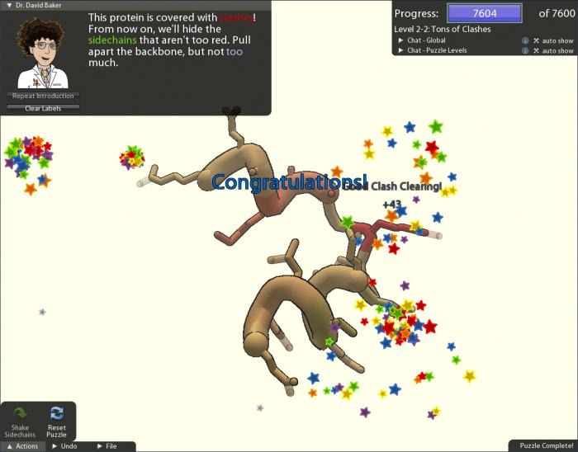
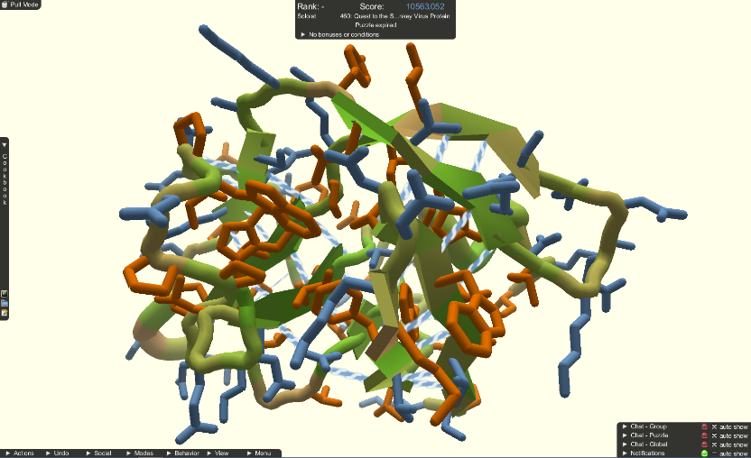
A protein causing AIDS in rhesus monkeys that hadn't been solved for 15 years was resolved by Foldit players and confirmed by x-ray crystallography. That paper was named "Article of the month" by Nature Structural & Molecular Biology in October 2011.

Slide 6
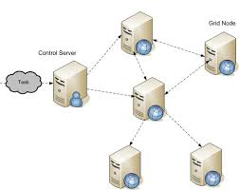
Power of game players….
Grid or Cloud Computing

Slide 7
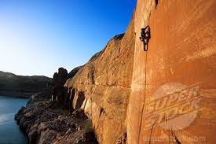
To create game-based interface for your research problem….
Game Players
Love to achieve
Love to explore
Love the victories
Love the recognition
Games
Are safe to fail
Are simple and easy to get started

Slide 8
Applying to Computational Ecology
Collaborators – Dr. Neo Martinez, Dr. Rich Williams, Dr. Eric Berlow, …
Foodwebs.org
Tens of Nature, Ecology Letters publications, TED talk speakers, etc
State-of-art computational model with multiple NSF grants over 10 years
https://www.youtube.com/watch?v=VxYM-RgVqTI

Slide 11
Possible Research Questions…
a. What human interactions with fishery ecosystems simultaneously lead to the greatest yield of preferred fish species and maintenance of the most ecosystem biomass and diversity?
b. How can different species of plant be extracted from an ecosystem for biofuels while maintaining the largest populations of endangered species?
c. How can humans most effectively sustain themselves with yields of wild foods from terrestrial and near shore ecosystems combined with limited agricultural potential available on small Pacific islands?

Slide 12
Bio-Diversity Research
Habitat Degradation
Bio-Diversity Research
Sustainability Research
Climate Change
Computational Ecosystem Research
(Structure and Dynamics of Ecological Network)

Slide 13
Current Address of Computational Ecology Research
Only recently has this understanding progressed to the point that realistically complex ecosystems can be computationally modeled.
Simpler model produces much less accurate data than more realistic ones
Shortage of computational ecologists and the difficulty of understanding the mathematical, computational, and ecological details of programming and running these models combined with analyzing the huge amounts of simulated data.

Slide 14
How can crowd computing help complex ecology research?
8 system parameters, 8 node parameters and 15 link parameters. In case of Serengeti web, there are 95 nodes and 547 links, then there are 8 system parameters, 760 node parameters and 8205 parameters that are all interdependent.
8*100*760*100*8205*100 = 48,000,000,000,000 cases if each parameter has about 100 interpolation gap.
Scientists run simulations by tweaking parameters to match to realistic food web parameter sets.
Can we use a game like FarmVille for players to nurture a ecosystem that is close to a realistic food web?

Slide 15
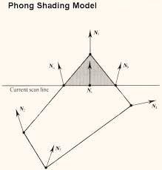
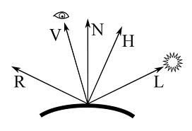
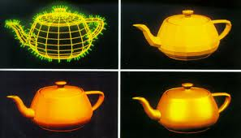
Analogy to Computer Graphics Phong shading (1973) Simplified Simulation of physical illumination

Slide 16
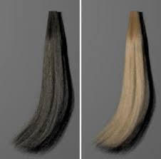
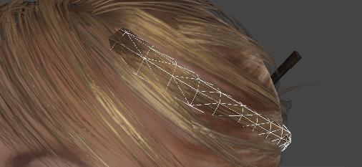
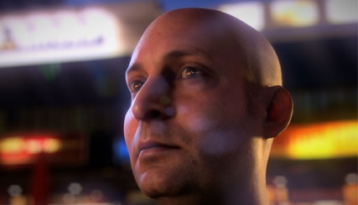
Illumination has been advanced….

Slide 17
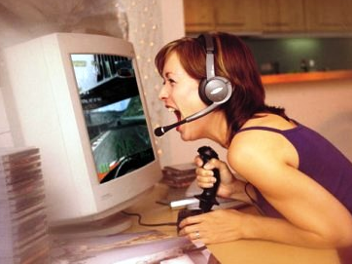
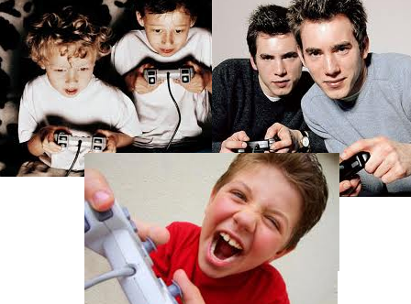
Time, effort
Money, etc
Scientists
Science Discovery
Entertainment
Time, effort
Gamification

Slide 18
What are steps to build science discovery game?
1. Establish a game-based interface to Computation Model
2. Test if the game is playable and fun
3. Train/educate game players?
4. Add games to produce scientific data

Slide 19
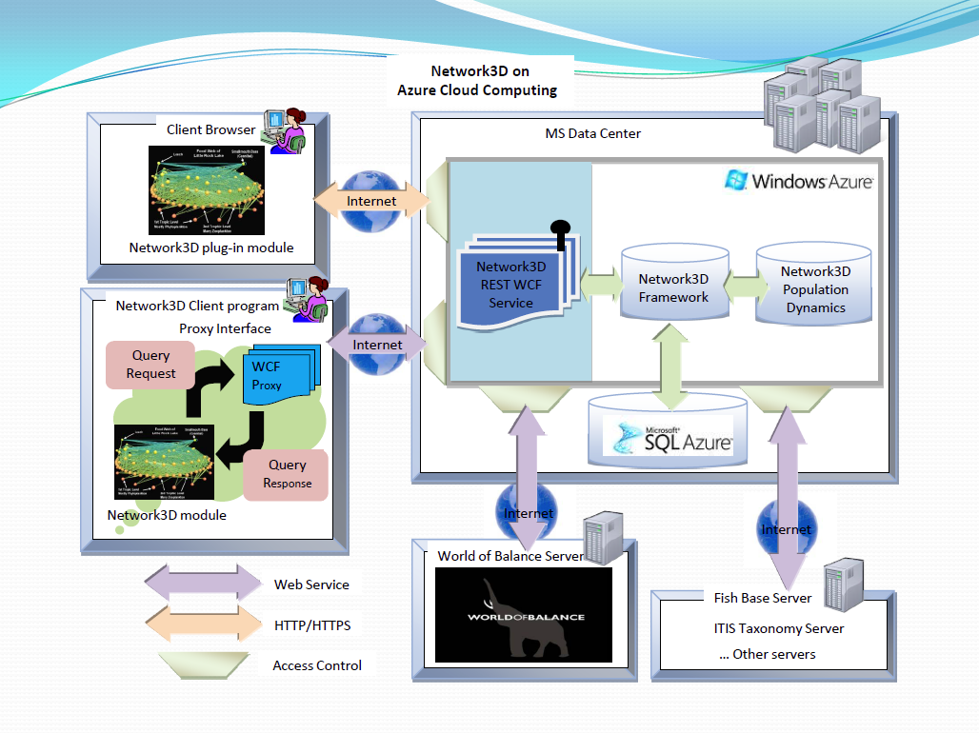

Slide 20
First Version of World of Balance
The name, World of Balance, comes from the idea of creating a balanced ecosystem.
The game requires you to manage an ecosystem by introducing the appropriate species, purchasable from the Shop, that will help you create a sustainable ecosystem to achieve the highest score as possible.
Highest score is calculated to encourage players to create more diverse ecosystem.
Environment score = ([log₂ (Total Biomass)] * 5)² + (# of Species)²

Slide 21
Design Principle World of Balance – Entertaining?
Is nurturing fun?
Farmville proved that yes!
Nurturing complex ecosystem is challenging, but success is rewarding.
WoB tries to guide players to succeed progressively; not too boring, not to challenging!
For some, nurturing is boring… unless they can do something after nurturing!!
PvE (like Farmville) players are collaboratively nurture habitat
PvP (like Starcraft) players are playing against other players and destroy the other’s eco system
Is competition or collaboration fun?
Showing off your achievements?
Working together to solve the challenging tasks?

Slide 22
http://smurf.sfsu.edu/~debugger/wb/guide_user_interface.php

Slide 23
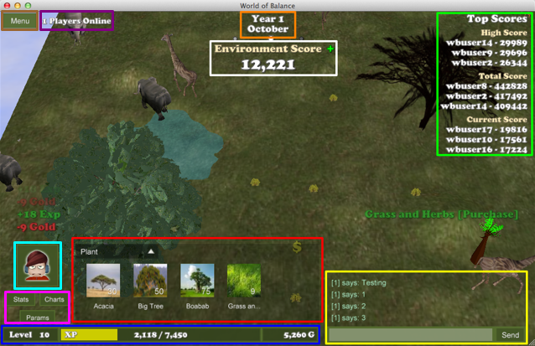

Slide 24
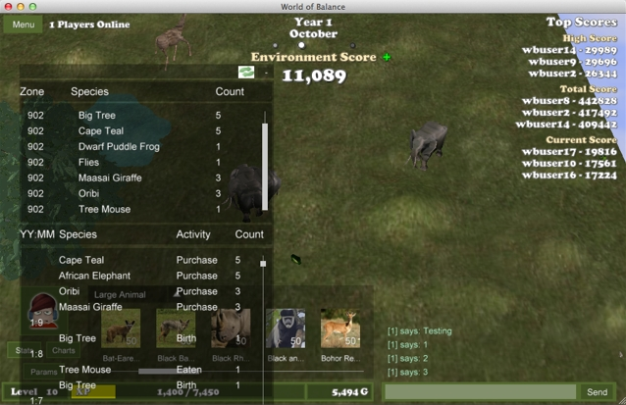
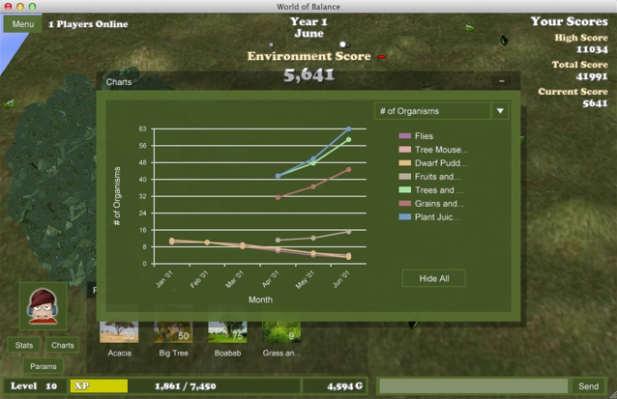

Slide 25
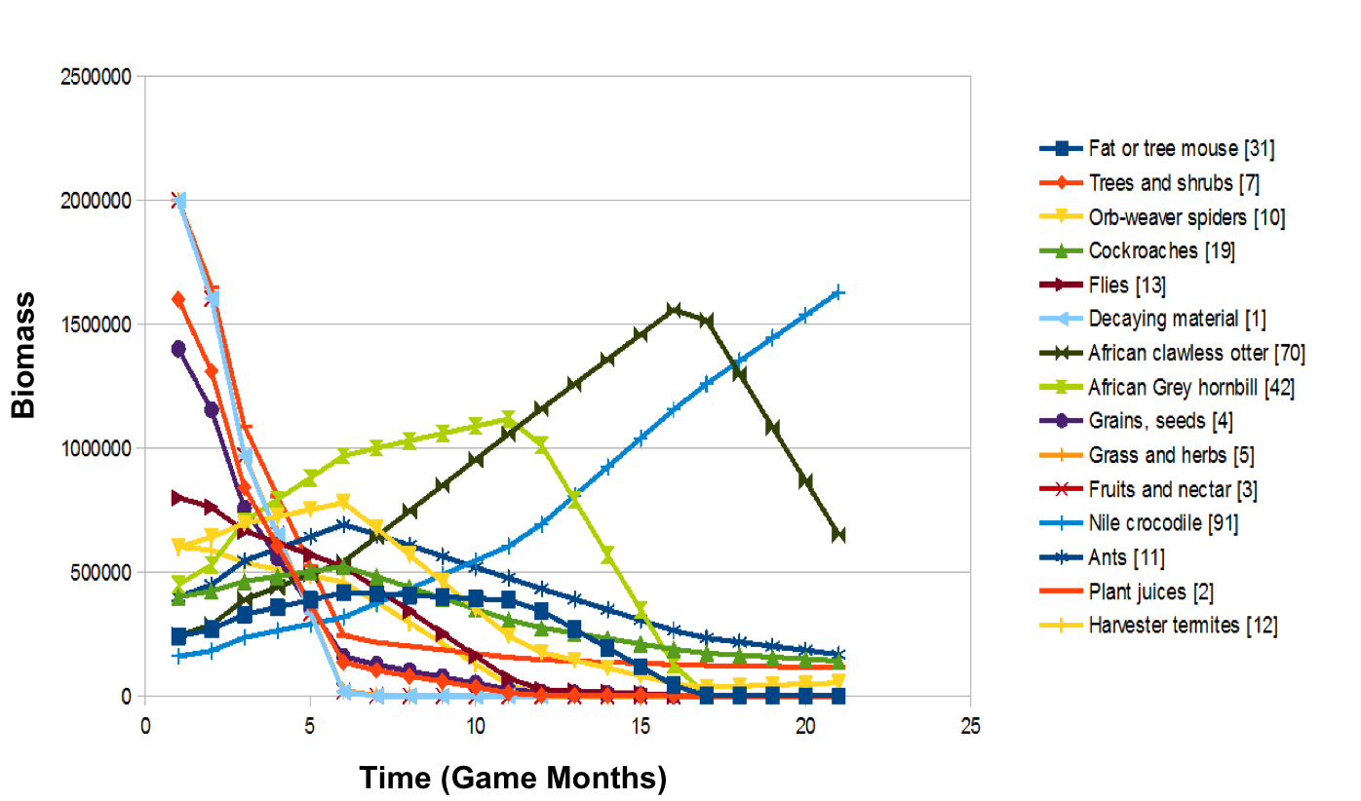
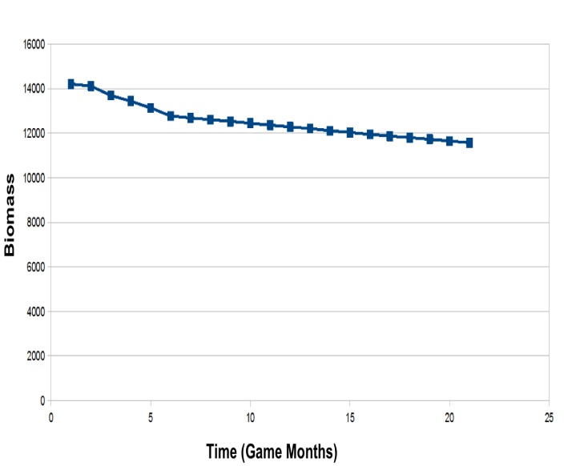
Selection of Initial Species and biomass allocation
Environment Score Changes over time
Corresponding Environment Score chart for an ecosystem with 15 species, not so good case.
Ecosystem with same 15 species, but different starting biomass and parameters. Not a good gameplay as species are quickly dying out.

Slide 26
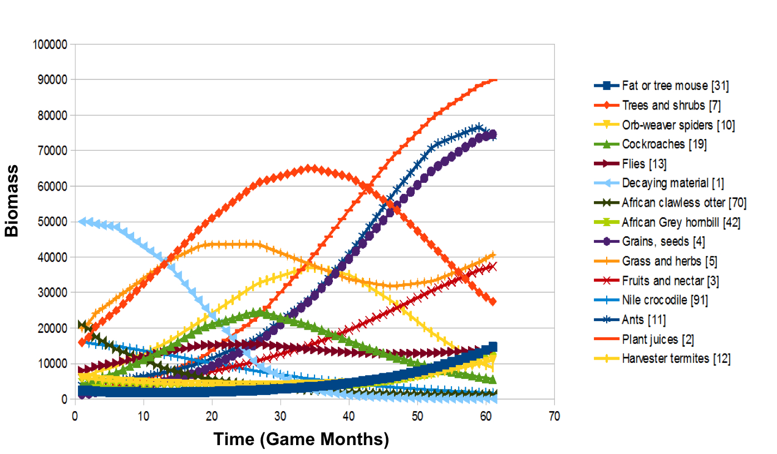
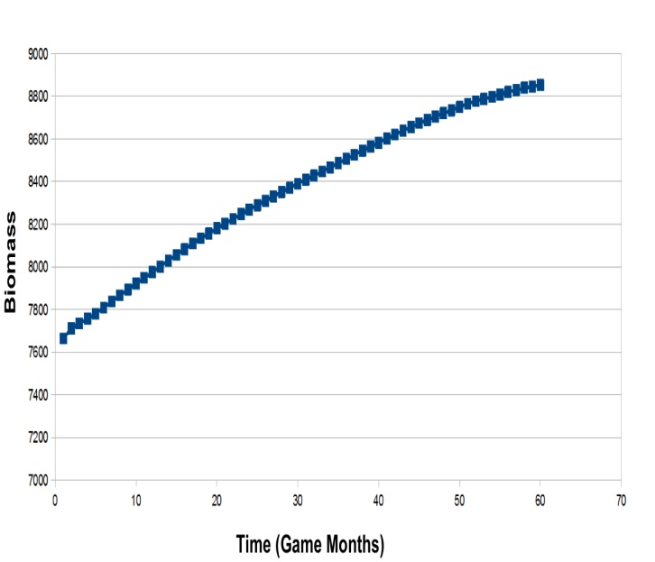
Selection of Initial Species and biomass allocation
Environment Score Changes over time
Corresponding Environment Score chart for an ecosystem with 15 species
Ecosystem with 15 species without user intervention

Slide 27
World of Balance – User Trial
Phase 1—User Engagement Evaluations
Over the course of 2 months (beginning of April, 2012 to beginning of June, 2013), 10 psychology undergraduate and graduate students participated in user engagement evaluation
Phase 2—Efficacy Testing of World of Balance
11 psychology undergraduate students (M age = 21.36; SD = 1.12; 4 males and 7 females), attending San Francisco State University. All participants successfully completed a 5-days study with approximately 10-12 hours of their participation including 8 hours and more of game playing.

Slide 28
World of Balance – User Trial
Serengeti Ecosystem General Knowledge Pre- and Post-Test: forced-choice questioned examined participants’ general understanding of the Serengeti ecosystem. Through comparing participant’s pre- and post-test scores, we examined whether participant’s understanding of Serengeti ecosystem was significantly increased (and improved) as the result of playing World of Balance for 8 hours.
User Engagement Pre- and Post-Test: mixture of Likert-scale as well as open-ended questions which examined (1) participant’s own perception of their knowledge gains and intrinsic motivation to learn about Serengeti ecosystem (2) participant’s positive affects, interactive and perceived engagement experience.
Constructive Feedbacks: Through detailed open-ended questions, participants were asked to provide constructive feedbacks on the ways for our research team to further improve World of Balance.

Slide 29
User Trial Results
Only after 8 hours of playing World of Balance, participant’s general knowledge of Serengeti ecosystem increased significantly as the result, t(10) = 3.81, p < 0.001 (Pre-test: M = 6.45; SD = 1.968; Post-test: M = 10.27; SD = 2.24).
Participants reported that they feel they knew a lot about the Serengeti ecosystem in general after playing World of Balance, t(10) = 1.09, p < 0.05 (Pre-Survey: M = 2.18; SD = 0.12; Post-Survey: M = 2.27; SD = 0.47).
Especially, their felt that they learned a lot about the species living in the Serengeti ecosystem, t(10) = 1.47; p < 0.001, (Pre-Survey: M = 2.27; SD = 0.46; Post-Survey: M = 3.18; SD = 1.07).
Not only their perception of knowledge about Seregenti ecosystem, participants also felt that they were more curious about the Serengeti ecosystem and would like to know more about it, t(1) = 0.71, p < 0.01, (Pre-Survey: M = 3.64; SD = 0.81; Post-Survey: M = 4.36; SD = 0.50).

Slide 30
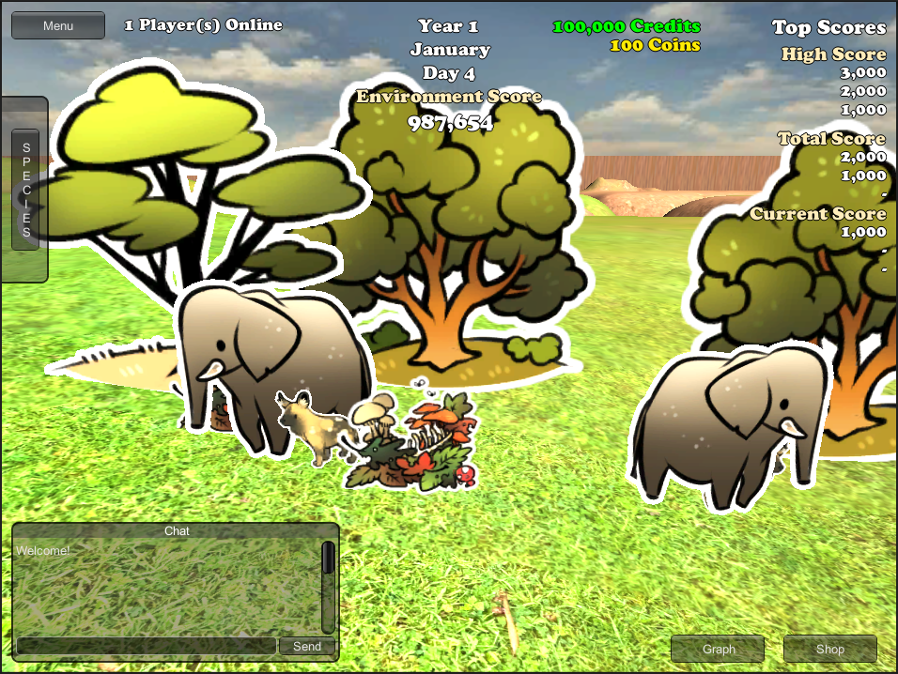
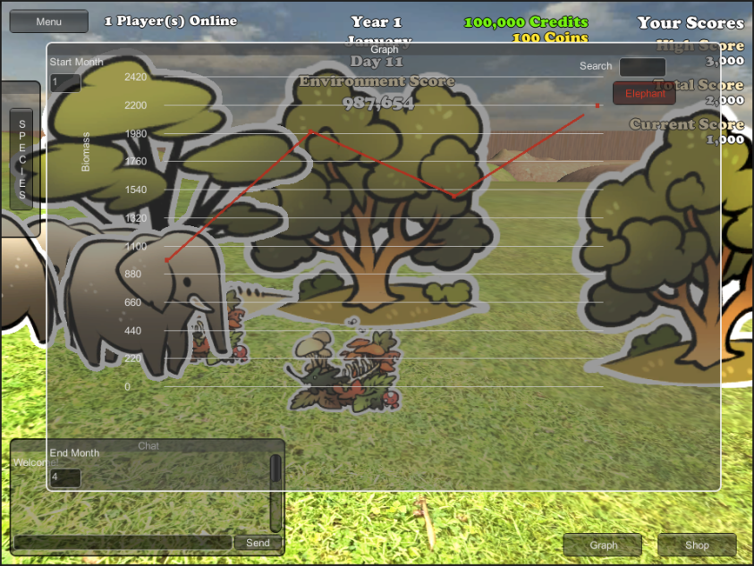
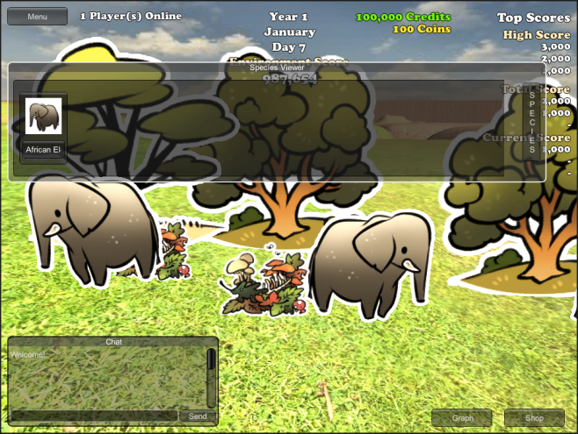

Slide 31
World of Balance components
Lobby
Clash of Species (CoS)
Cards of Wild (CoW)
Don’t Eat Me (DEM)
SDD (Sea Divided)
Convergence (single and multiplayer games)
Running Rhino (RR)

Slide 32
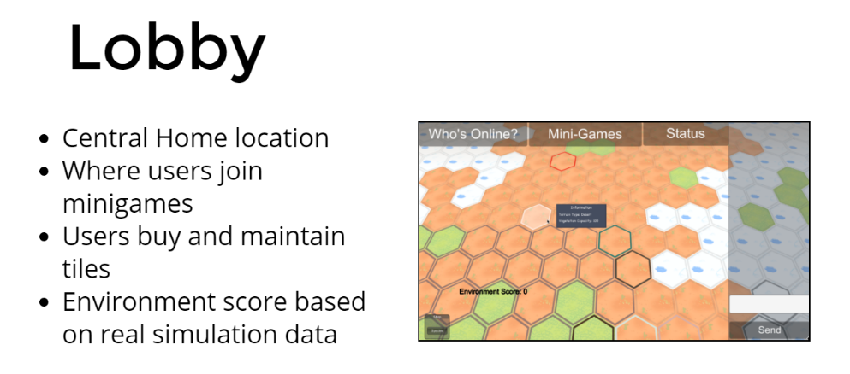
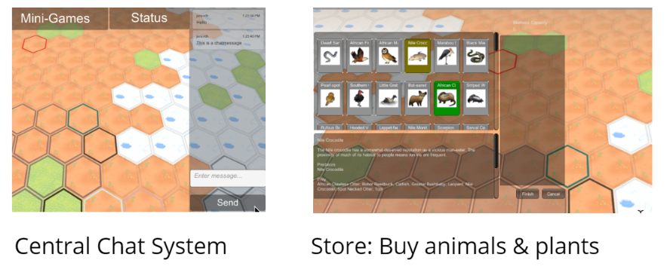

Slide 33
https://www.youtube.com/watch?v=co0bp6ng39A

Slide 34
https://www.youtube.com/watch?v=SjQeL-9cTls

Slide 35
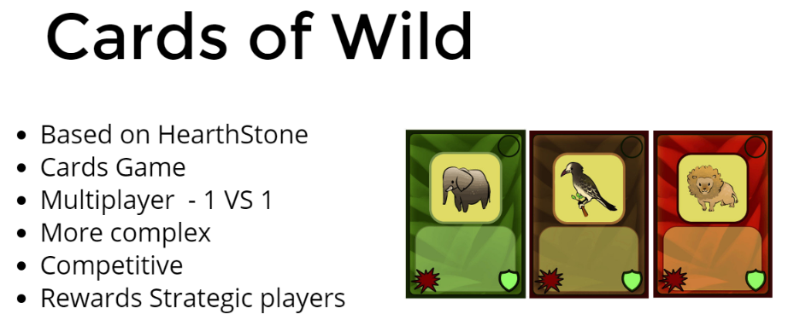
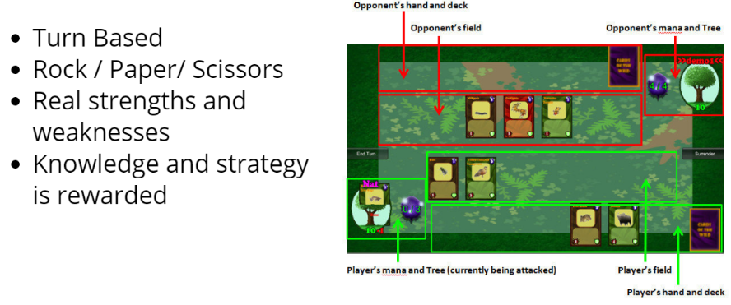
https://www.youtube.com/watch?v=YIZ4It69Llo

Slide 36
https://www.youtube.com/watch?v=Oa33bpqA8Pw

Slide 37
https://www.youtube.com/watch?v=co_Qe2wr9FI&feature=youtu.be

Slide 38
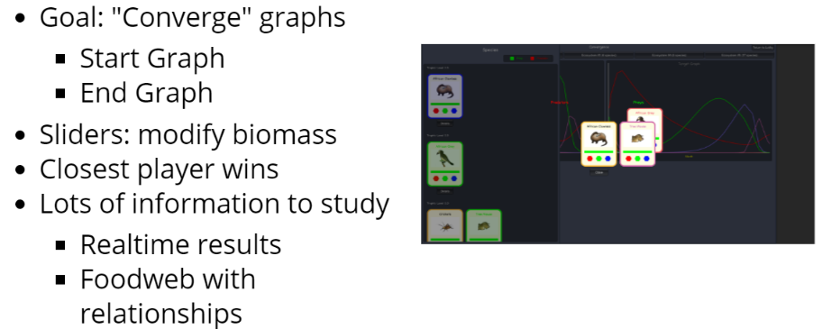
https://www.youtube.com/watch?v=lMy5PIsJQsc

Slide 39
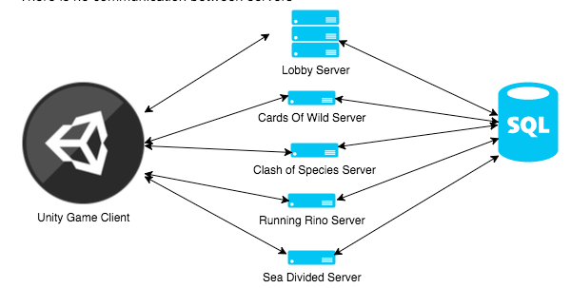
Software Architecture

Slide 40
Development
NSF Education Project - Transforming Experience of Computer Science Software Development through Multiplayer Online Game Classroom Collaboration in Industrial Format
30-35 students develops one game during the whole semester.

Slide 41
Objectives
Motivate students to learn essential CS core content (3D graphics, networks, databases, software engineering) by self-teaching, team-teaching with specific tasks.
Teach effective communication, presentation and collaboration skills
(Very large) Team project!!!

Slide 42
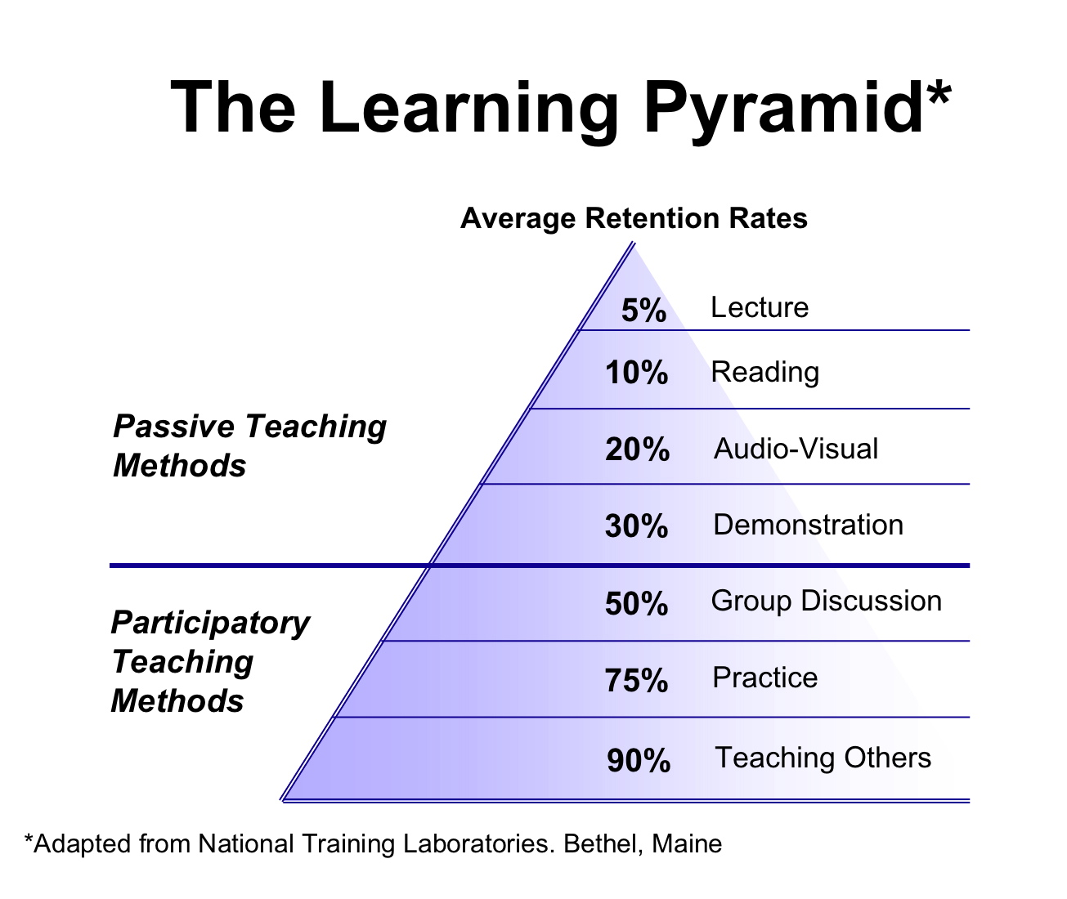

Slide 43
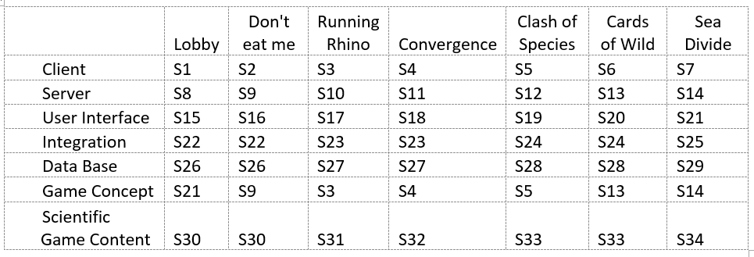
Team Assignment (Spring 2016)

Slide 44
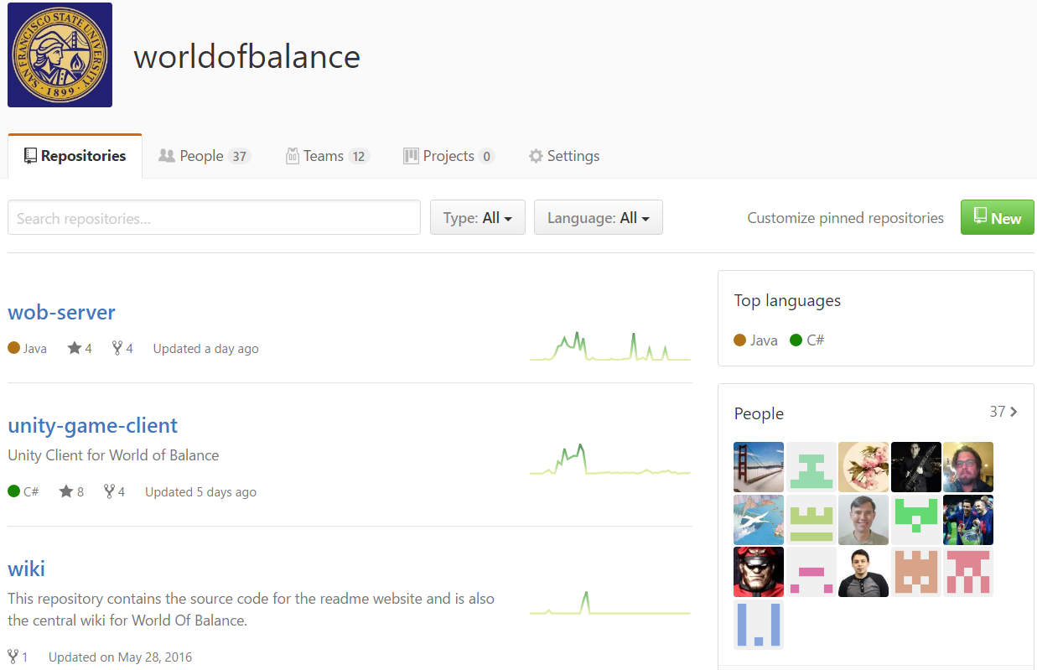

Slide 45
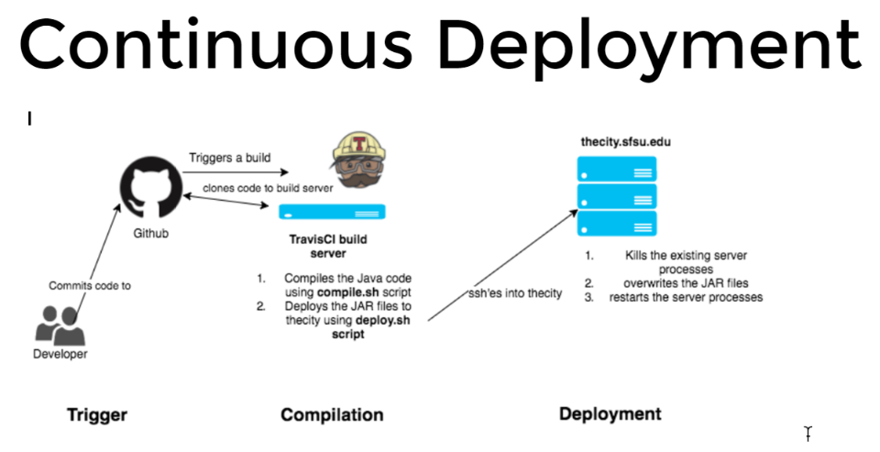

Slide 46
Thank you!! Questions?

Slide 47
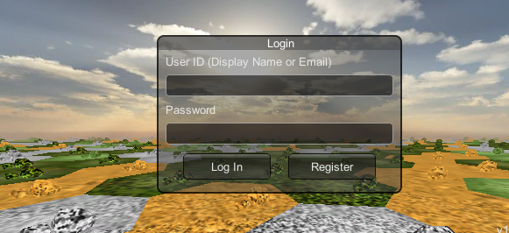
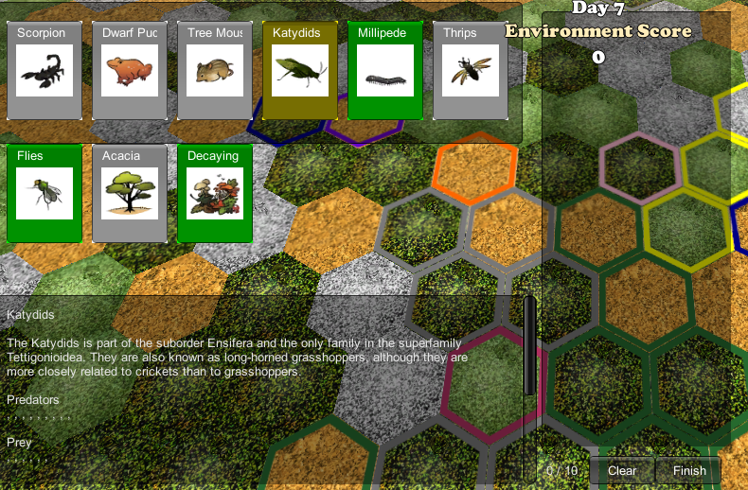
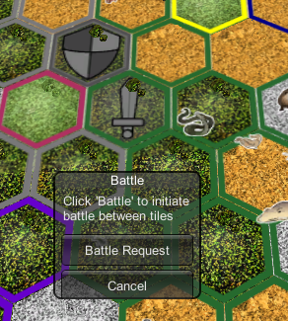
Lobby Team

Slide 48
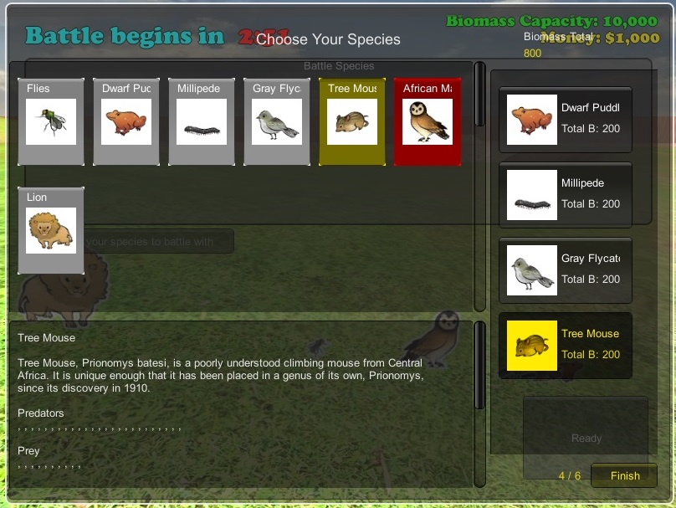
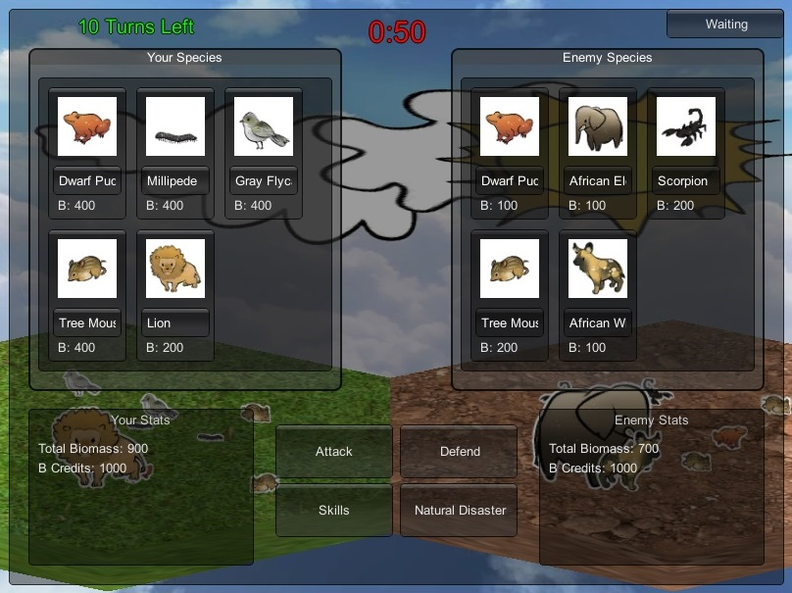
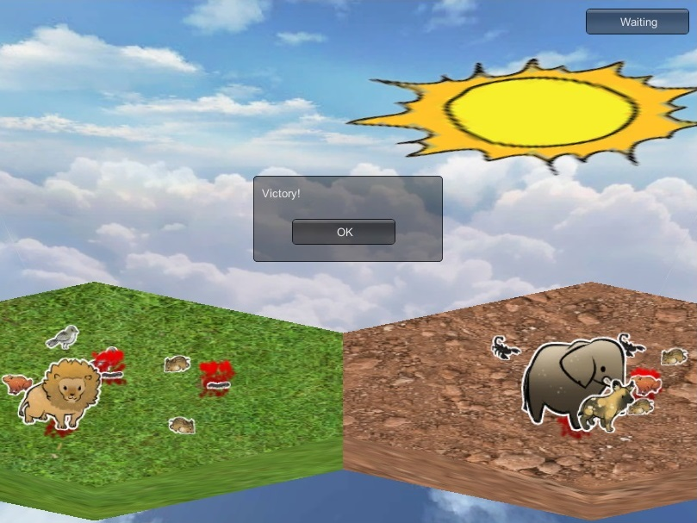
Battle Team

