Slide 1
Optimizing Ecological Sustainability by Integrating Intuition and Machine Learning via Gamification
Ben Saylor¹, Anagha Kulkarni¹, Neo Martinez², Ilmi Yoon¹
bsaylor@mail.sfsu.edu, ak@sfsu.edu, neomartinez@email.arizona.edu, ilmi@sfsu.edu
¹San Francisco State University, ²University of Arizona

Slide 2
Introduction
Improving human-computer interactions (e.g. using gamification) can aid understanding of ecological sustainability
Helping to parameterize models of the complex structure and nonlinear dynamics of ecological systems
A prominent family of such models includes allometric trophic network (ATN) models

Slide 3
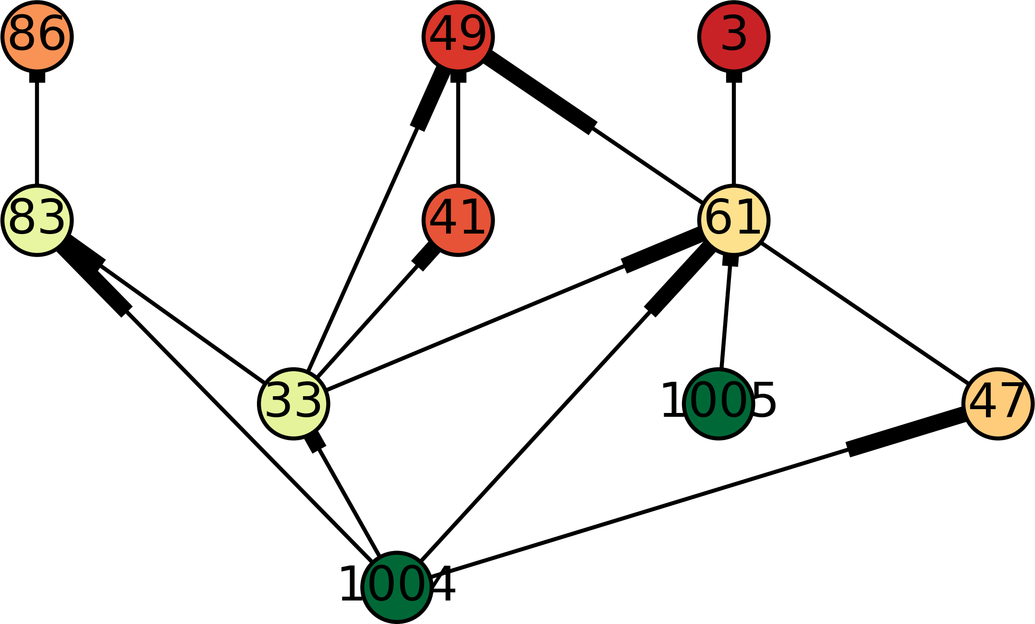
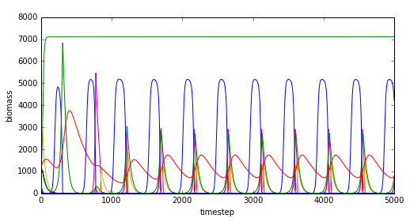
Allometric Trophic Network models
Flow of energy and biomass through food webs
Metabolic rates estimated from body size
Calculate species’ changes in biomass as:
gains due to photosynthesis and feeding
losses due to metabolism and being consumed
Systems of differential equations with species-level and link-level parameters
Large parameter space, which poses challenges in parameterizing models to:
dynamically sustain many species
accurately predict organismal abundance in nature

Slide 4
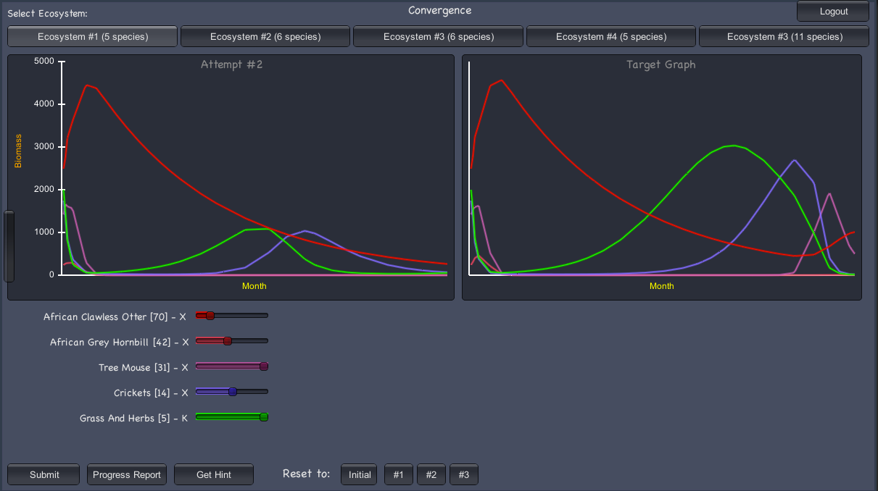
Convergence Game
Part of World of Balance (WoB) game in which players act as stewards of virtual Serengeti ecosystems
Players try to match target data (time series of different species’ biomass) by parameterizing an ATN model
Players compete for best match, betting with WoB game credits

Slide 5
Problem Definition
Even small food webs have a large parameter space
Network of interdependencies means a small change to one species’ parameter impacts dynamics of all species
Finding parameter values to match target data is nontrivial
Develop an intuitive understanding of ecological dynamics and sustainability by supporting players to discover parameter values that replicate the target ecosystem

Slide 6
Methodology
To improve target biomass data used for Convergence game
To identify promising ranges of parameter values to display to players as hints

Slide 7
Methodology: species selection
Food web in WoB consists of 87 species from the Serengeti
We keep gameplay manageable by deriving smaller food webs
Generate subgraphs with the following properties:
Having exactly one connected component
Containing all observed trophic links between species
Having specified number of plant species
Having no incomplete food chains
Minimizing plant eaters lacking predators
3: | African Fish Eagle
33: | Cape Teal
41: | Striped Weasel
47: | White-Bellied Bustard
49: | African Marsh Owl
61: | Leopard Tortoise
83: | Bush Pig
86: | Lion
1004: | Grains and Seeds
1005: | Grass and Herbs

Slide 8
Methodology: parameter space exploration and simulation
Sets of 1000 simulations with randomized parameters
Each parameter value is independently drawn from a uniform distribution between 50% and 150% of its default value
(WoB database contains default parameter values for each species based on measurements and established models of metabolic rates)

Slide 9
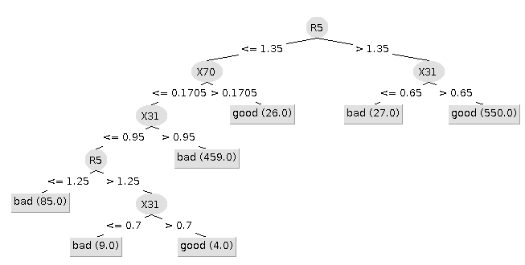
Methodology: classification of simulation results
Use simulation data to train machine learning algorithm to predict ecosystem health based on parameters
Calculate linear time trend of WoB’s environment score (measure of total biomass of ecosystem, weighted toward higher trophic levels)
Label simulations as “good” or “bad” if their score trend falls within the top 25% or bottom 25% of simulations, respectively
Train Weka’s C4.5 decision tree to predict class label from parameters

Slide 10
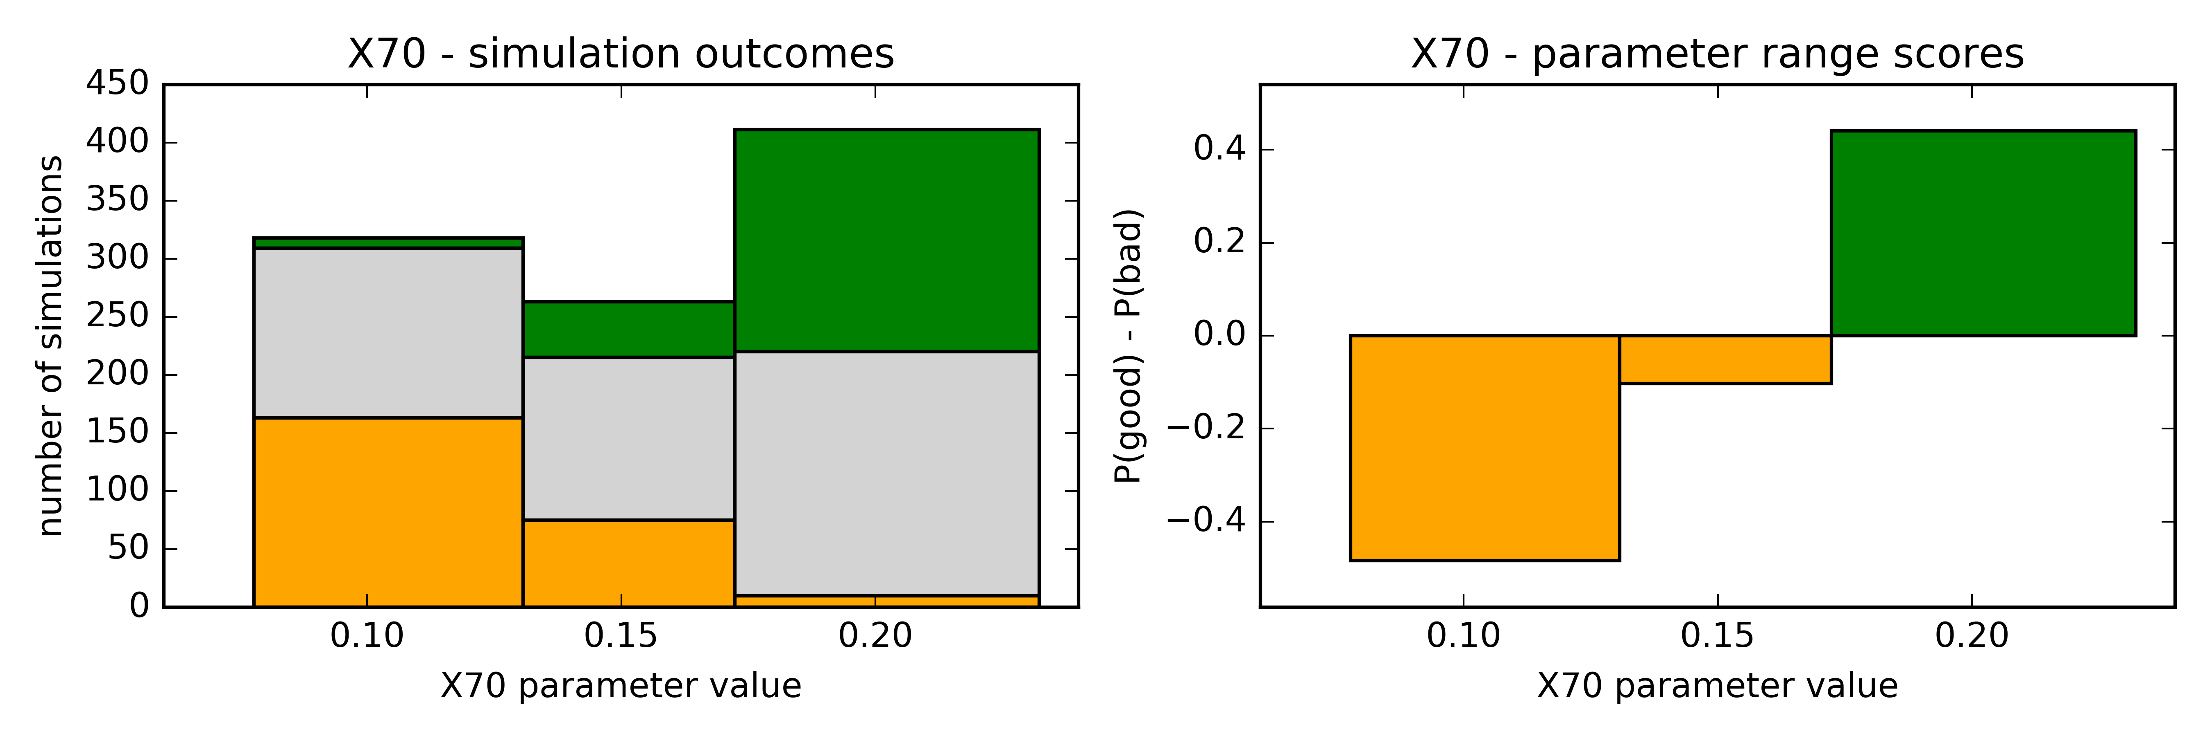
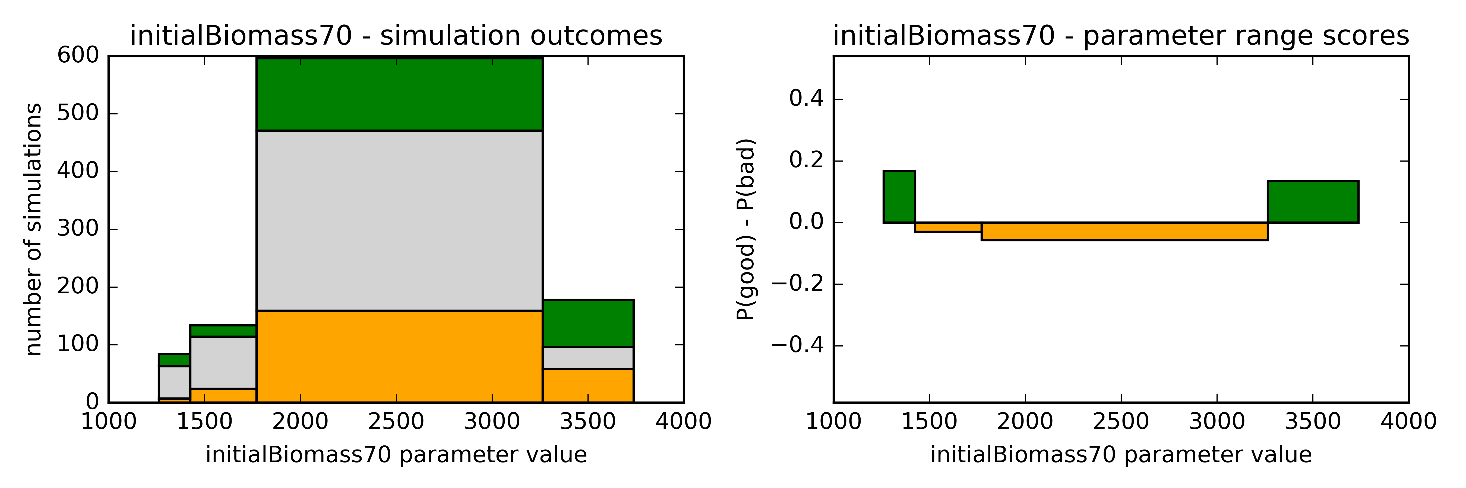
Methodology: evaluation of parameter ranges
Use structure of decision trees to derive and evaluate parameter ranges
Decision tree provides set of branching values for each parameter that maximize predictive accuracy
For ranges defined by branching values, assign score
P(good) – P(bad)

Slide 11
Experimental design
User study planned for Fall 2016 will compare two groups of Multiplayer Convergence players
First group is given hints (promising parameter ranges)
Second group plays without such hints
Compare how quickly and accurately the two groups find parameters that fit the the target data

Slide 12
Conclusion
Allometric trophic network models have large parameter search space
Gamification supported by machine learning can provide insights that help parameterize ATN models
We are developing a foundation for testing hypotheses about guiding Convergence players using information about the parameter space derived from machine learning

